Slide 1
Image processing, analysis and machine vision
Dong Sun Park
Tuesday, April 28, 2020

Slide 2
Contents
Pixel brightness transformations
Geometric transformations
Local pre-processing
Image restoration

Slide 3
Pre-processing
Both input and output are intensity images.
Does not increase image information content.
Helps to suppress information that is not relevant to the specific image processing or analysis task.

Slide 4
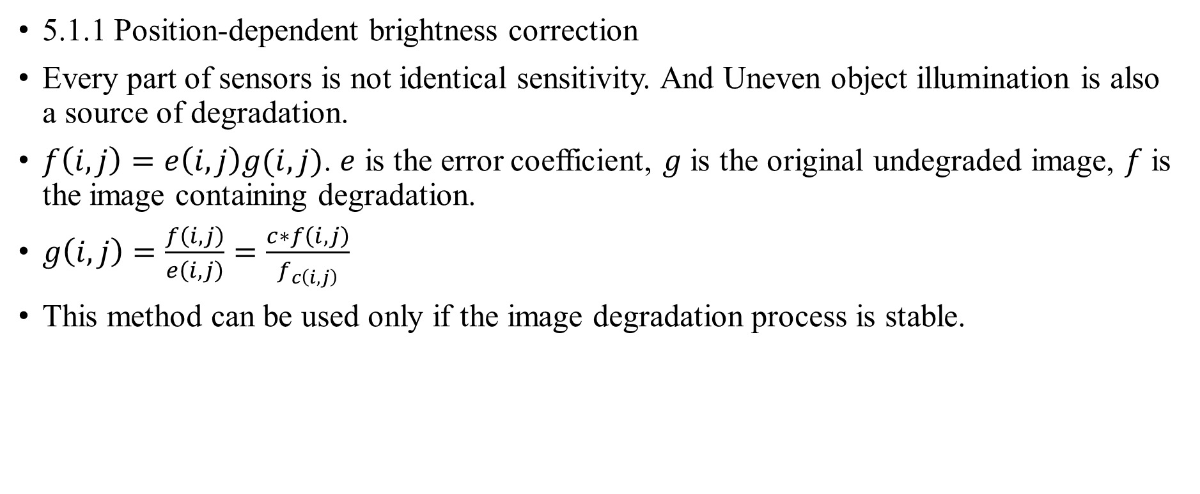
5.1 Pixel brightness transformations
5.1.1 Position-dependent brightness correction
Every part of sensors is not identical sensitivity. And Uneven object illumination is also a source of degradation.
$f\left(i,j\right)=e\left(i,j\right)g(i,j)$. $e$ is the error coefficient, $g$ is the original undegraded image, $f$ is the image containing degradation.
$g\left(i,j\right)=\frac{f\left(i,j\right)}{e\left(i,j\right)}=\frac{c∗f\left(i,j\right)}{f_{c\left(i,j\right)}}$
This method can be used only if the image degradation process is stable.

Slide 5
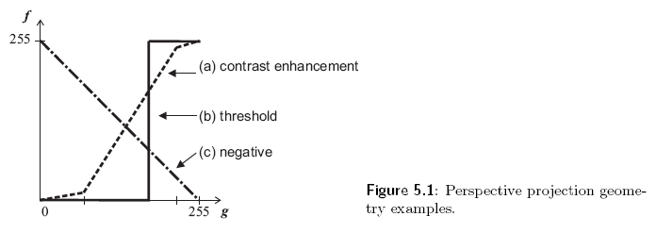
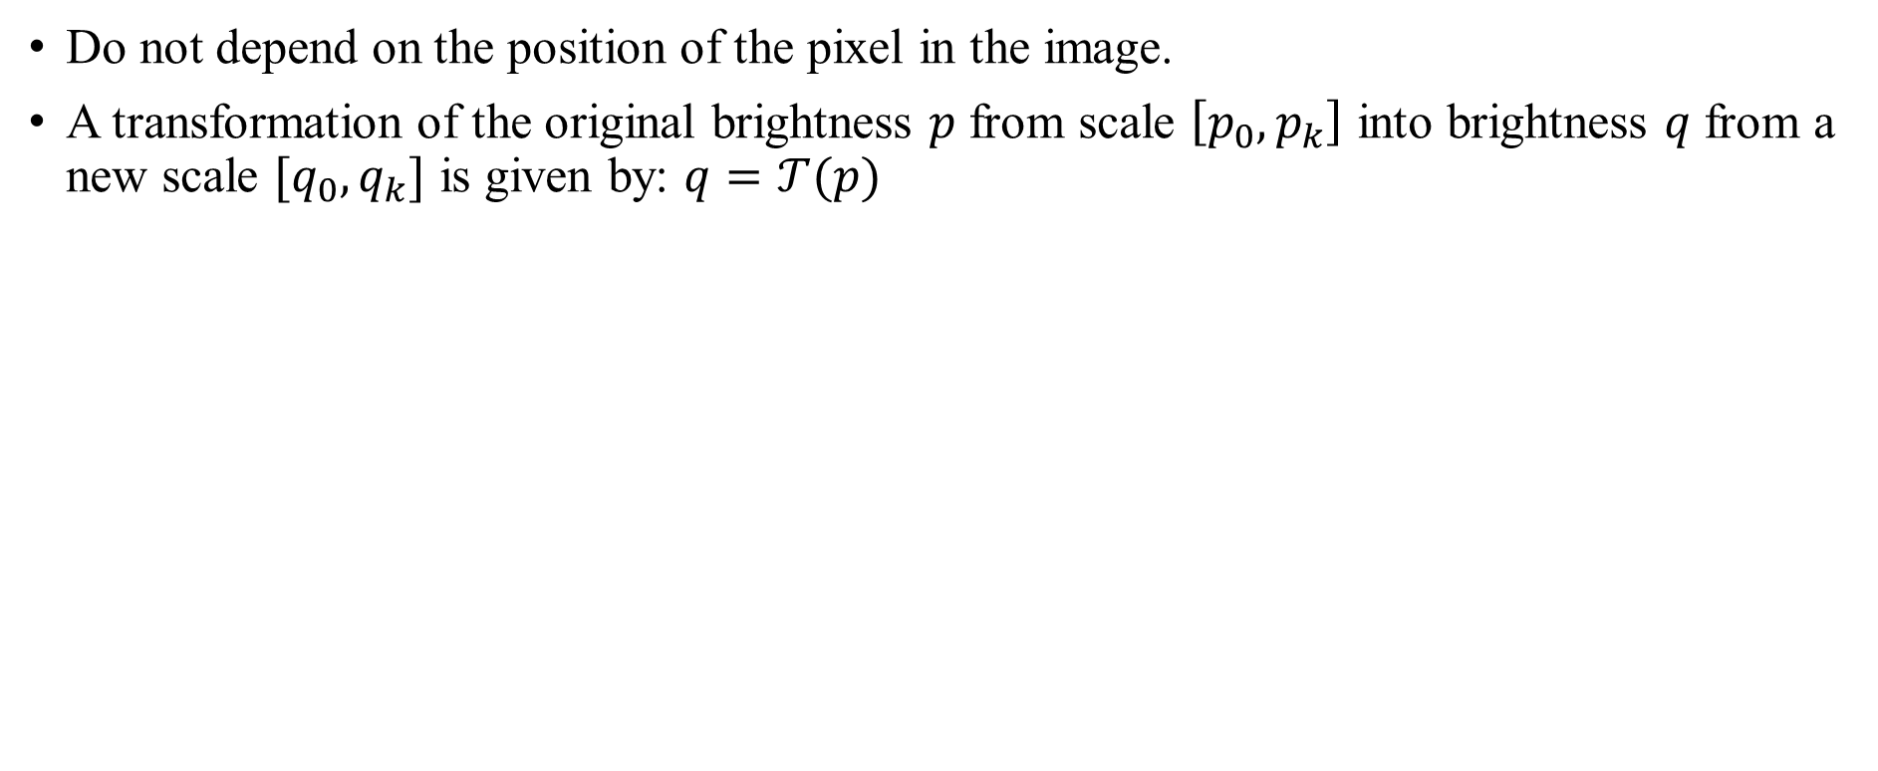
5.1.2 Gray-scale transformation
Do not depend on the position of the pixel in the image.
A transformation of the original brightness $p$ from scale $\left[p_{0},p_{k}\right]$ into brightness $q$ from a new scale $[q_{0},q_{k}]$ is given by: $q=𝒯(p)$

Slide 6
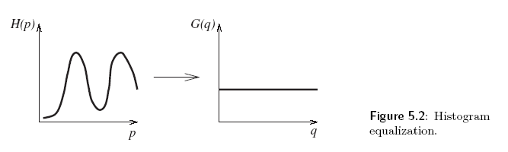
A gray-scale transformation for contrast enhancement is usually found automatically using the histogram equalization technique.

Slide 7
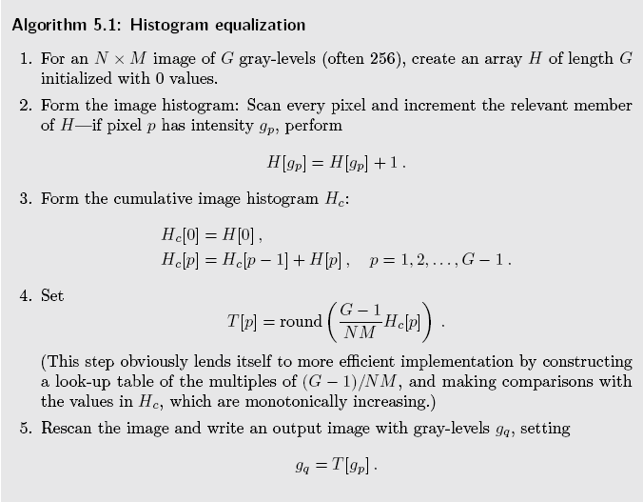

Slide 8
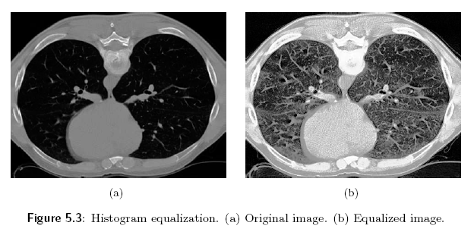
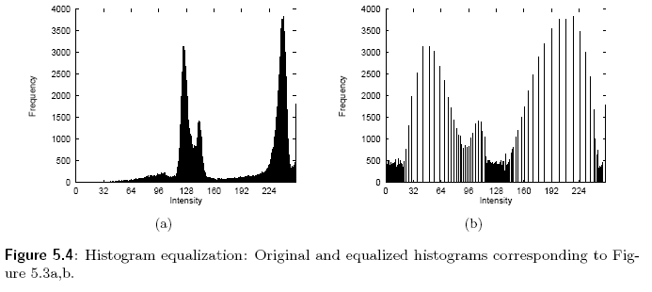

Slide 9
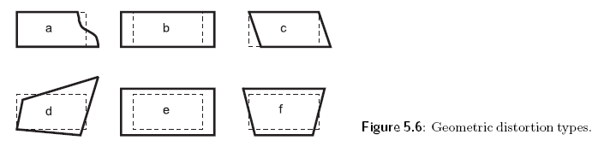
5.2 Geometric transformations
Permit elimination of the geometric distortion that occurs when an image is captured. If one attempts to match two different images of the same object, a geometric transformation may be needed.
Panoramic distortion (Figure 5.6b) appears in line scanners with the mirror rotating at constant speed. Line non-linearity distortion(Figure 5.6a) is caused by variable distance of the object from the scanner mirror. The rotation of the Earth during image capture in a mechanical scanner generates skew distortion (Figure 5. 6c) . Change of distance from the sensor induces change of scale distortion (Figure 5.6e) . Perspective projection canses perspective distortion (Figure 5.6f) .

Slide 10
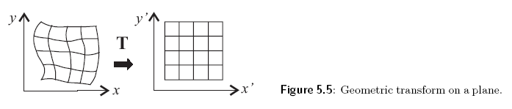
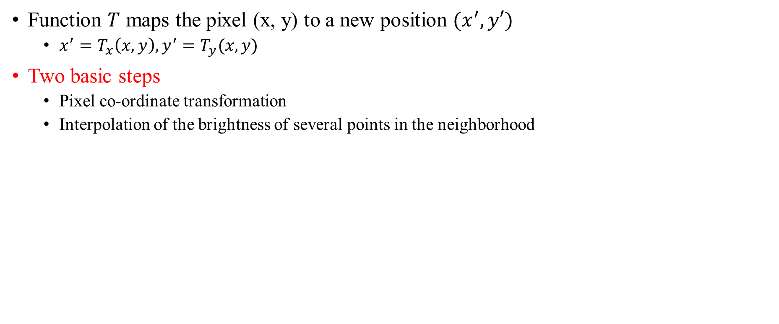
Function $T$ maps the pixel (x, y) to a new position $(x^{′}, y′)$
$x^{′}=T_{x}\left(x,y\right), y^{′}=T_{y}(x,y)$
Two basic steps
Pixel co-ordinate transformation
Interpolation of the brightness of several points in the neighborhood

Slide 11
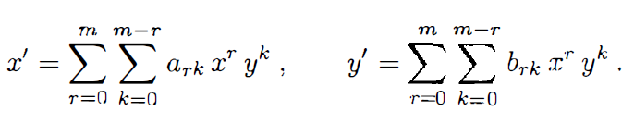
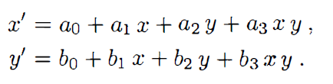
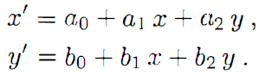
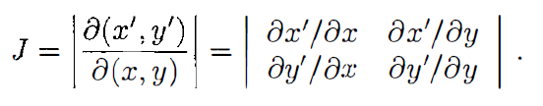
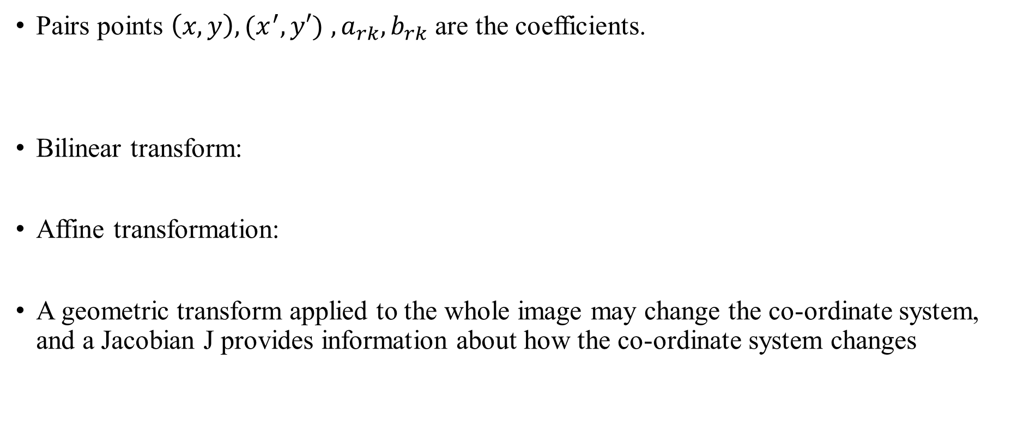
5.2.1 Pixel co-ordinate transformations
Pairs points $\left(x,y\right), (x^{′}, y′)$ $,a_{rk},b_{rk}$ are the coefficients.
Bilinear transform:
Affine transformation:
A geometric transform applied to the whole image may change the co-ordinate system, and a Jacobian J provides information about how the co-ordinate system changes

Slide 12
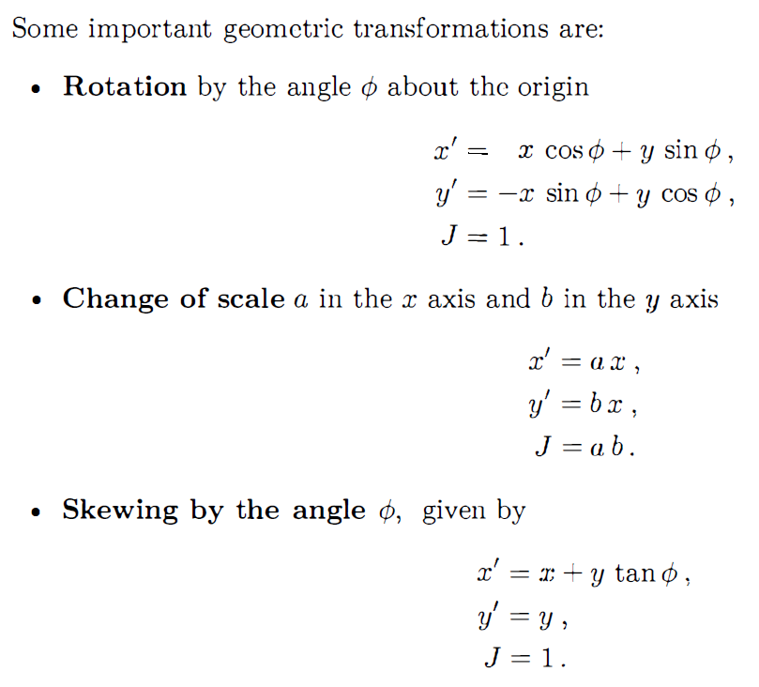

Slide 13
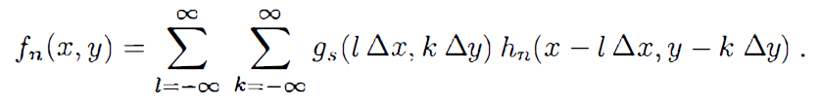
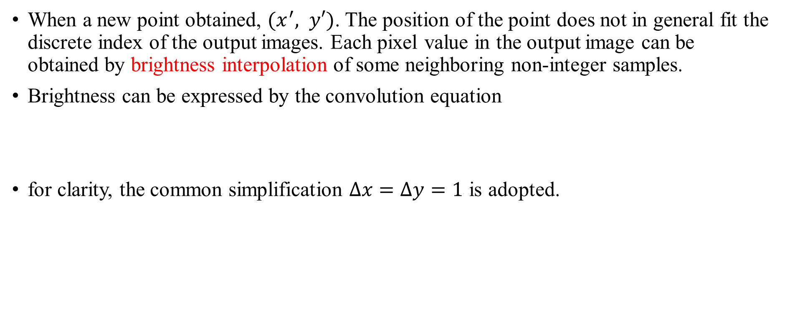
5.2.2 Brightness interpolation
When a new point obtained, $(x^{′}, y′)$. The position of the point does not in general fit the discrete index of the output images. Each pixel value in the output image can be obtained by brightness interpolation of some neighboring non-integer samples.
Brightness can be expressed by the convolution equation
for clarity, the common simplification $Δx=Δy=1$ is adopted.

Slide 14
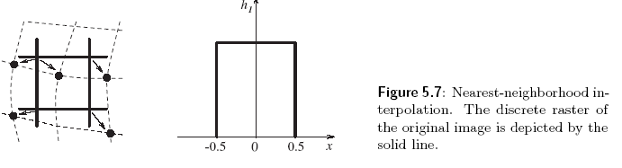
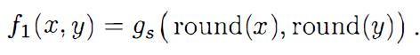
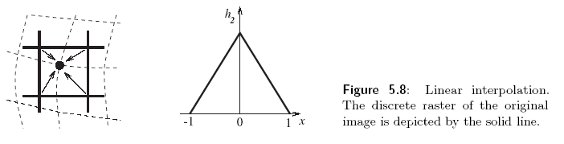
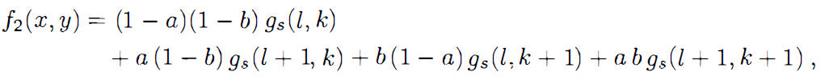
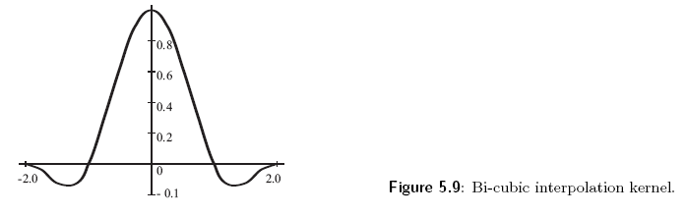
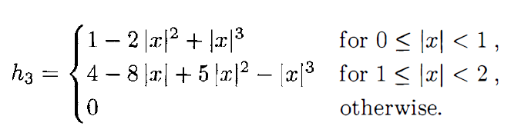
Nearest-neighborhood interpolation
Linear interpolation
Bi-cubic interpolation

Slide 15
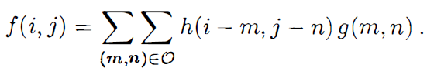
5.3 Local pre-processing
Use a small neighborhood of a pixel in an input image to produce a new brightness value in the output image. This kind of operations are called also filtration or filtering.
Two groups:
Smoothing: aims to suppress noise or other small fluctuations in the image
Gradient operator: indicate rapid changes in the image.
Or
Linear: every pixel has same impact
Non-linear: different pixels will have different impacts

Slide 16
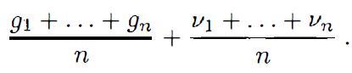
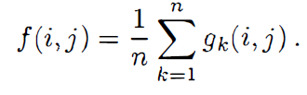
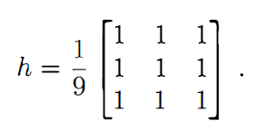
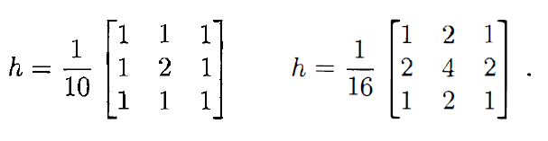
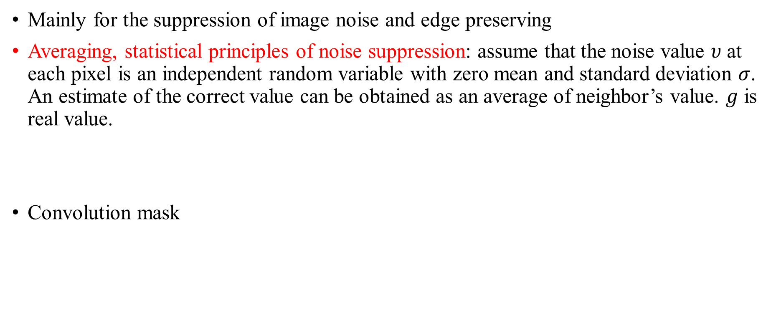
5.3.1 Image smoothing
Mainly for the suppression of image noise and edge preserving
Averaging, statistical principles of noise suppression: assume that the noise value $υ$ at each pixel is an independent random variable with zero mean and standard deviation $σ$. An estimate of the correct value can be obtained as an average of neighbor’s value. $g$ is real value.
Convolution mask

Slide 17
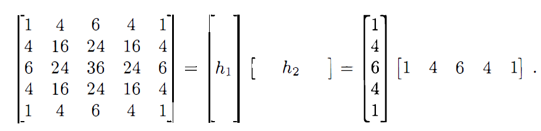
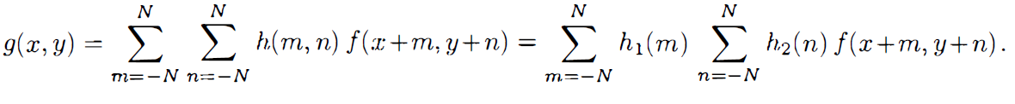
Separable filters, a filter can be decomposed into a product of two 1D vectors
We can use it to reduce computation.

Slide 18
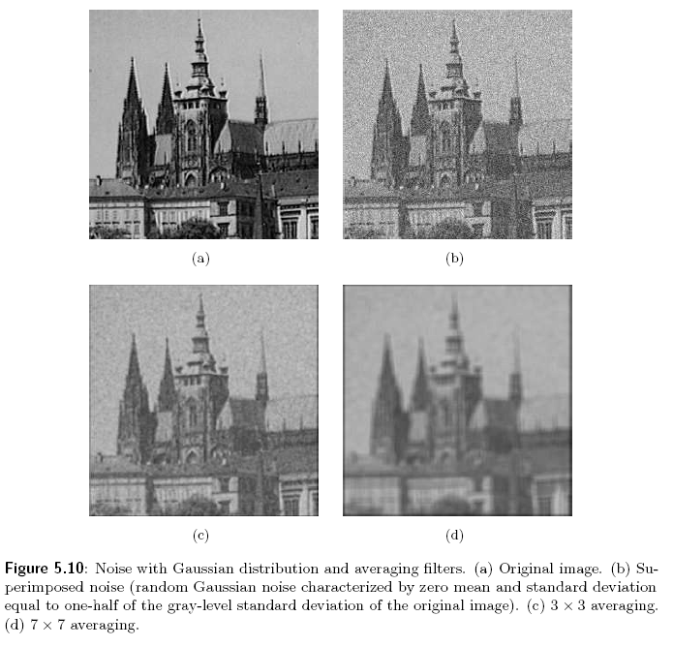

Slide 19
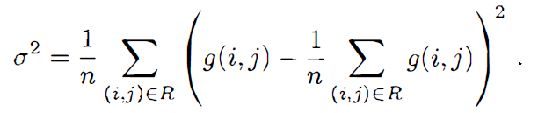
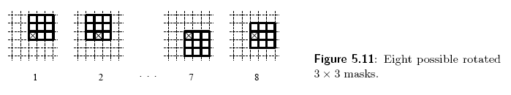
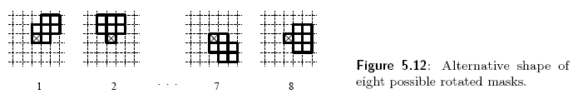
Averaging using a rotating mask: a rotating mask is a non-linear smoothing method that avoids edge blurring by searching for the homogeneous part of the current pixel neighborhood and the resulting image is in fact sharpened

Slide 20

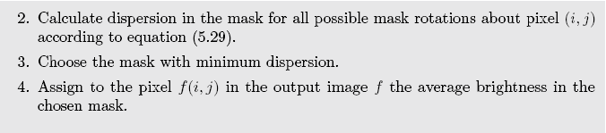
Can be used iteratively

Slide 21
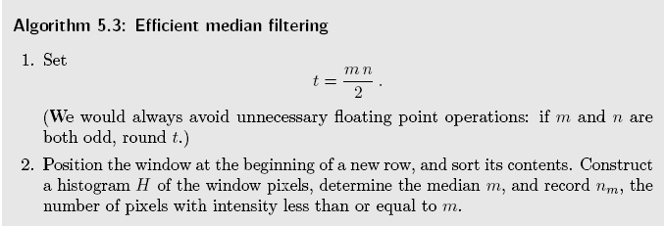
Median filtering, a non-linear smoothing method that reduces the blurring of edges, is not affected by individual noise spikes and so median smoothing eliminates impulse noise quite well. Does not blur edges much, it can be applied iteratively.

Slide 22
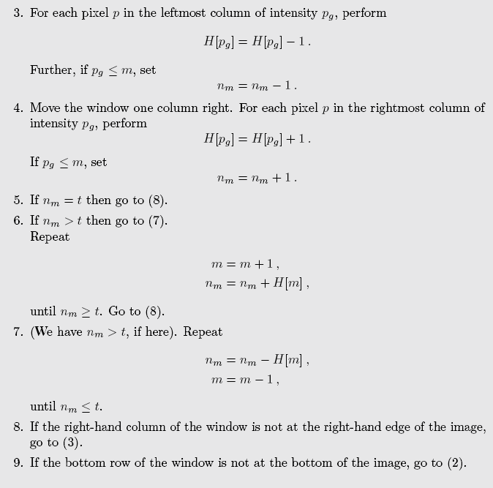

Slide 23
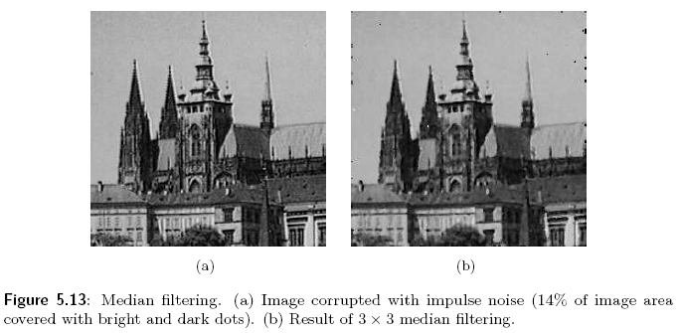

Slide 24
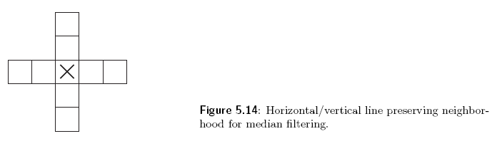
The main disadvantage in a rectangular neighborhood is its damaging of thin lines and sharp corners in the image, which can be avoid if another shape of neighborhood is used.

Slide 25
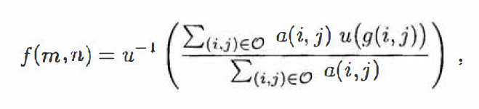
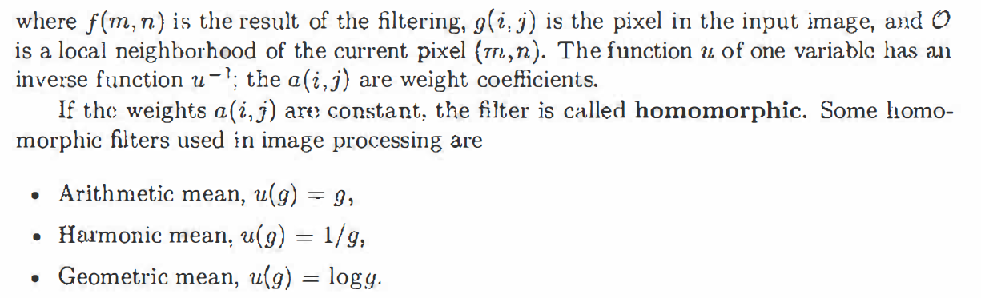
Non-linear mean filter

Slide 26
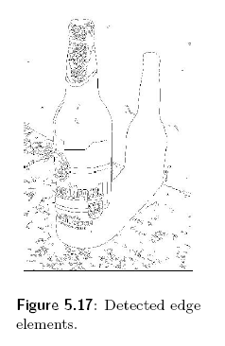
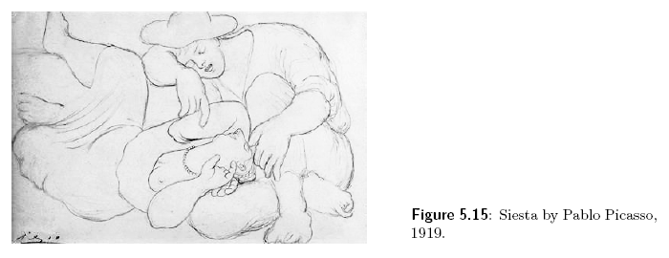
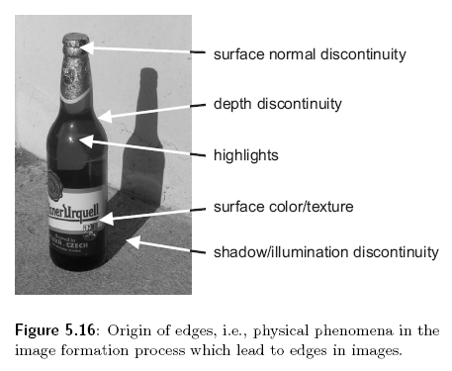
5.3.2 Edge detectors
Are used to locate changes in the intensity function, edges are pixels where this function changes abruptly.
These changes are important for image perception.
Edge detection provides appropriate generalization of the image data. Painters of line drawings perform such a generalization.

Slide 27
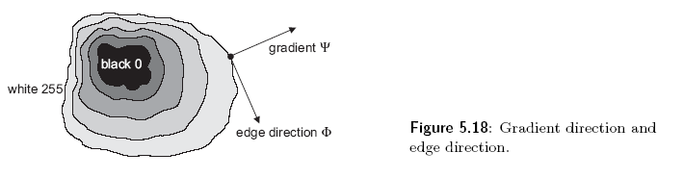
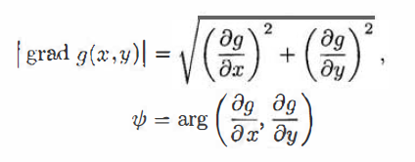
Derives can be used to describe the changes of continuous functions. An image function depends on two variables, co-ordinates in the image plane and so operators describing edges are expressed by partial derivatives.
An edge is a property attached to an individual pixel and is calculated from the image function behavior in a neighborhood of that pixel. It is a vector variable with two components, magnitude and direction. The former is the magnitude of the gradient, and latter is rotated with respect to the gradient direction by -90 degrees.
Edges are often used in image analysis for finding region boundaries.

Slide 28
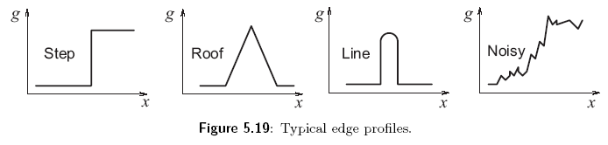
The edge profile in the gradient direction is typical for objects.
Roof edges are typical for objects corresponding to thin lines. Edge detectors are usually tuned for some type of edge profile.

Slide 29
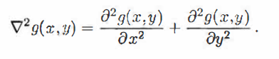

Sometimes we are interested only in edge magnitudes without regard to their orientations, a linear differential operator called the Laplacian may then be used.
Laplacian is invariant to rotation in the image.
Image sharpening has the objective of making edges stepper. The sharpened output image $f$ is obtained from the input image $g$ is $f\left(i,j\right)=g\left(i,j\right)−C∗S(i,j)$. C is positive coefficient which gives the strength of sharpening and $S(i,j)$ is a measure of the image function sheerness, calculated using a gradient operator.
Laplacian is very often used for this purpose.

Slide 30

An example of image sharpening using a Laplacian.

Slide 31
Gradient operators as a measure of edge sheerness can be divided into three categories.
1. operators approximating derivatives of the image function using difference.
2. operators based on the zero-crossings of the image function second derive.
3. operators which attempt to match an image function to a parametric to a parametric model of edges.
And fuzzy logic, neural networks, or wavelets can also be used to do it.

Slide 32






Roberts operator
(high sensitivity to noise)
Laplace operator
(responds doubly to some edges in the image)
Prewitt operator (compass)
Sobel operator
Robinson operator

Slide 33


Kirsch operator

Slide 34
5.3.3 zero-crossings of the second derivative
Object boundaries are the most important cues that link an intensity image with its interpretation.
Edge detection techniques existing at that time were based on convolution in very small neighborhoods and worked well only for specific images. The main disadvantage of these edge detectors is their dependence on the size of the object and sensitivity to noise.
An edge detection technique based on the zero-crossings of the second derivative explores the fact that a step edge corresponds to an abrupt change in the image function.
The first derivative of the image function should have an extremum at the position corresponding to the edge in the image, and so the second derivative should be zero at the same position.

Slide 35


Slide 36



2D Gaussian smoothing operator is given by
After do something, we can get a LoG operator

Slide 37


Slide 38

5.3.4 Scale in image processing
The essential problem is scale.
There is seldom a sound reason for choosing a particular size of neighborhood, since the right size depends on the size of the objects under investigation.
Different description levels are easily interpreted as different scales in the domain of digital images.

Slide 39
Three approach to construct a multi-scale primitive shape description
1. Process planar noisy curves at a range of scales-the segment of curve that represents the underlying structure of the scene needs to be found.
2. Scale-space filtering, describe signals qualitatively with respect to scale.
3. Canny edge detector.

Slide 40

5.3.5 Canny edge detection
The optimality of the detector is related to three criteria.

Slide 41

Canny's derivation of a new edge detector is based o n several ideas.

Slide 42


Slide 43



Slide 44
5.3.6 Parametric edge models
Parametric models are based on the idea that the discrete image intensity function can be considered a sampled and noisy approximation of the underlying continuous or piecewise continuous image intensity function.
piecewise continuous function estimates called facets are used to each image pixel.
To provide an edge detection example, consider a bi-cubic facet model
Edge detectors based on parametric models describe edges more precisely than convolution-based edge detectors.

Slide 45
5.3.7 Edges in multi-spectral images
One pixel in a multi-spectral image is described by an n-dimensional vector, and brightness values in n spectral bands are the vector components.
First method: detect edges separately in individual image spectral components using the ordinary local gradient operators.
Second: use the brightness difference of the same pixel in two different spectral components.
Third: create a multi-spectral edge detector which uses brightness information from all n spectral bands;

Slide 46


5.3.8 Local pre-processing in the frequency domain
Fourier transform makes convolution of two images in the frequency domain very easy.
F: Fourier transform, H: convolution filter.
* represents an element-by-element multiplication of matrices F and H. The filtered image g can be obtained by applying the inverse Fourier transform to G.

Slide 47



Slide 48


Slide 49



Slide 50

Another useful pre-processing method in frequency domain is an instance of homomorphic filtering. Can be used to remove multiplicative noise. Can increase contrast and normalize image intensity at the same time.

Slide 51


Slide 52

5.3.9 Line detection by local pre-processing operators
Not only local operations as mentioned before.
Line finding, line thinning, line filling, and finding interest points or locations of interest.
Line finding operator aims to find very thin curves in the image; it is assumed that curves do not bend sharply. The presence of a. line may be detected by local convolution of the image with convolution kernels which serve as line patterns.

Slide 53

5.3.10 Detection of corners (interest points)
In many cases it is advantageous to find pairs of corresponding points in two similar images. The same transformation usually holds for almost all pixels of the image. The correspondence is examined among a much smaller number of points, called interest points.
An interest point should have some typical local property.
If square objects are present in the image, then corners are very good interest points.

Slide 54

The corner in the image can abo be defined as a pixel in its small neighborhood where are two dominant and different edge directions.
Corner detectors are not usually very robust.
The simplest corner detector is the Moravec detector which is maximal in pixels with high contrast. These points arc on corners and sharp edges.

Slide 55



Harris corner detector improved upon Moravec detector by considering the differential of the corner score (sum of square differences) .

Slide 56


Slide 57

5.3.11 Detection of maximally stable extremal regions
if the image is rescaled or transformed projectively, the output of Harris detector changes rapidly.
Maximally Stable Extremal Regions (MSERs) are an example of all image structure that can he repeatably detected not only after translations and rotations, but also after similarity and affine transforms of an image.

Slide 58


Slide 59

5.4 image restoration
Pre-processing methods that aim to suppress degradation using knowledge about its nature arc called image restoration. Most image restoration methods are based on convolution applied globally to the whole image.
Two groups of methods:
Deterministic methods are applicable to images with little noise and a known degradation function.
Stochastic techniques try to find the best restoration according to a particular stochastic criterion, e.g. , a least-squares method.
Degradation can be then expressed as convolution:
v describes the noise
h is invariant with respect to position in the image.

Slide 60



5.4.1 Degradations that are easy to restore
Three types of degradations that can be easily expressed mathematically and also restored simply in images.
We can get G=HF from last slide formation.
Relative motion of the camera and object: Assume an image is acquired with a camera with a mechanical shutter
Wrong lens focus: Image smoothing caused by imperfect focus of a thin lens can be described
Atmospheric turbulence: Atmospheric turbulence is degradation that needs to be restored in remote sensing and astronomy. It is caused by temperature non-homogeneity in the atmosphere that deviates passing light rays.
C is a constant that depends on the type of turbulence

Slide 61


5.4.2 Inverse filtration
Inverse filtering uses the assumption that degradation was caused by a linear function and considers the additive noise as another source of degradation.
Assume noises are independent of the signal. So after applying the fourier transform we can have
The degradation can be eliminated using the restoration filter with a transfer function that is inverse to the degradation

Slide 62


5.4.3 Wiener filtration
Inverse filtration gives poor results in pixels suffering from noise, since the information about noise properties is not taken into account.
How about incorporates a priori knowledge about the noise properties in the image restoration formula?

Slide 63



